Slide 1


Explore the new features of
bestIMAGE 5.60 CAM Plus, CAM smart
December 2012

Slide 2

General:
Supporting Windows 8.
CAM smart:
Supporting new Device smartLEX 696x.
Completely new machine software optimized for finger operation via a touch screen.
Job wizard:
Job creation has been revolutionary simplified and is now based on a wizard interview where customer just provides some basic information and the system generates the complete job in a couple of seconds.
Several approved machine settings for "SPG Prints Screens" are pre-installed.
  4 standard job templates are pre-installed:
  Standard templates range from very basic single file job layout up to a full featured job with registration marks and text sections.
  3 customer specific templates are free of charge:
  According to customers "technical drawing" templates featured job templates with registration marks, text fields (containing macros) and even Logo images can be created.
CAM Plus Features:
Supporting new Device DLX 703 (LAMS plate engraver + on the fly UV exposer).
Job wizard for textile systems:
Job creation has been revolutionary simplified and is now based on a wizard interview where customer just provides some basic information and the system generates the complete job in a couple of seconds.
Several approved machine settings for "SPG Prints Screens" are pre-installed.
  4 standard job templates are pre-installed:
  Standard templates range from very basic single file job layout up to a full featured job with registration marks and text sections.
  3 customer specific templates are free of charge:
  According to customers "technical drawing" templates featured job templates with registration marks, text fields (containing macros) and even Logo images can be created.
Auto positioning feature for inlay Text/Logo inside Registration mark objects.
It is now possible to define a full automatic screen inflation (additional to the user definable mode).
"Automatic continue after suction warning" can be configured now if machine has suction vacuum sensor and automatic filter cleaning unit.
It is now possible to assign 1 production calibration set to multiple device types.
It is now possible to hide all "default" production calibrations.

Slide 3
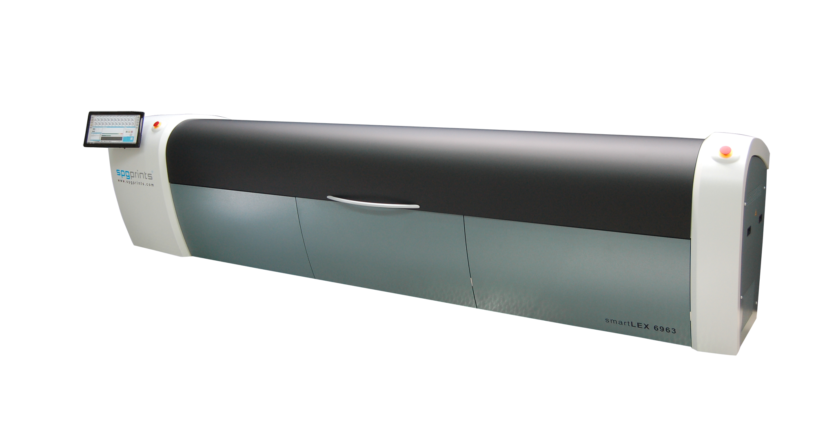
Supporting new device smartLEX 696X
(textile screen exposer)

Slide 4
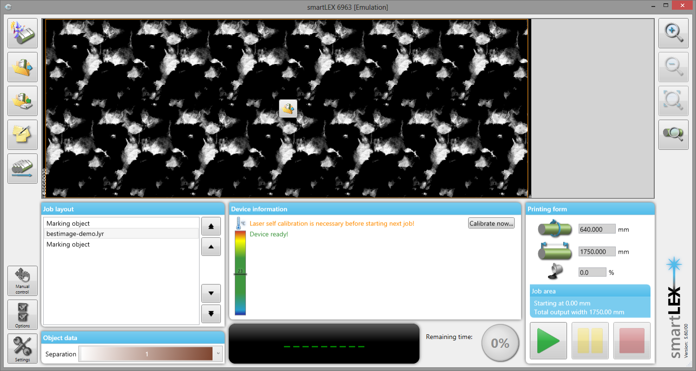
smartLEX has a new user interface which is optimized for finger operation.
Complete output process has been improved to make it as simple as possible to be able to produce screens nearly without any training (training videos are provided).
Job management tools:
Create, Load, Save, Spooling
Job layout display
Zoom and Preview tools
File replace button
Job layout list
“objects”
Manual control for machine
Job options, machine settings
Object details
(parameter)
Machine status
Output controls

Slide 5

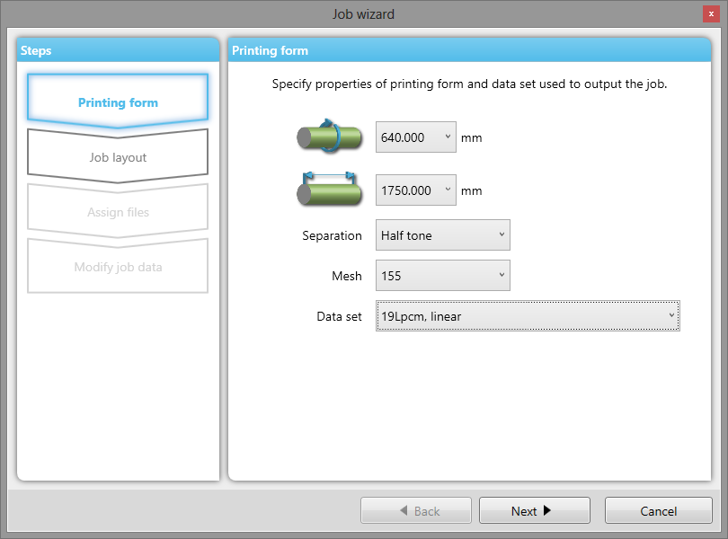
Job wizard for textile systems (based on CAM smart)
Job creation has been revolutionary simplified and is now based on a wizard interview where customer just provides some basic information and the system generates the complete job in a couple of seconds.
Several approved machine settings for "SPG Prints Screens" are pre-installed.
  4 standard job templates are pre-installed:
  Standard templates range from very basic single file job layout up to a full featured job with registration marks and text sections.
  3 customer specific templates are free of charge:
  According to customers "technical drawing" full featured job templates with registration marks, text fields (containing macros) and even Logo images can be created.
1
On smartLEX 696X you get a list of
settings matching to your selected
type of Separation (Halftone, Flat)
type of screen (Mesh),
and can select out of typically about
3 settings.
No need to worry about raster settings
and output settings to get a good result.

Slide 6
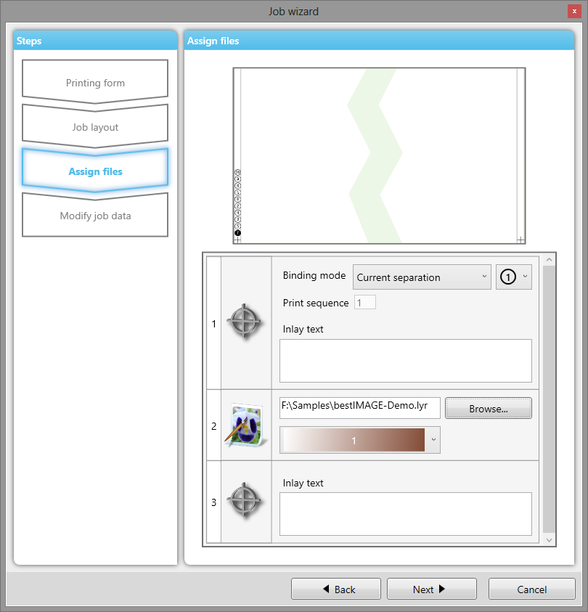
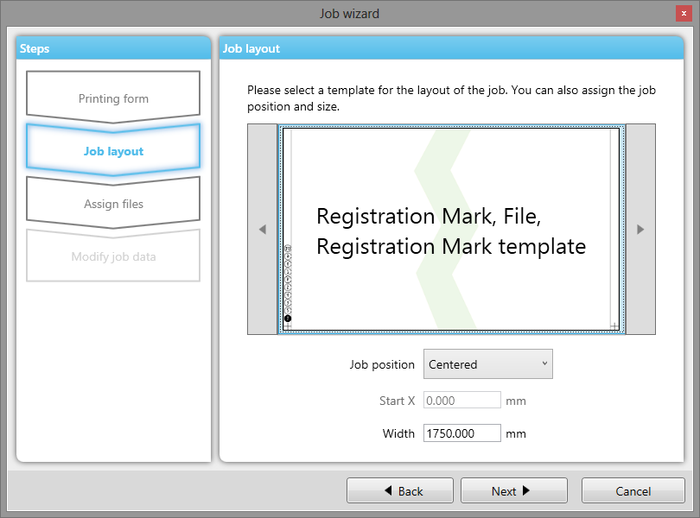
2
3
Select job layout and position
Select job object properties (files, text, print sequence mark shapes, etc.)

Slide 7
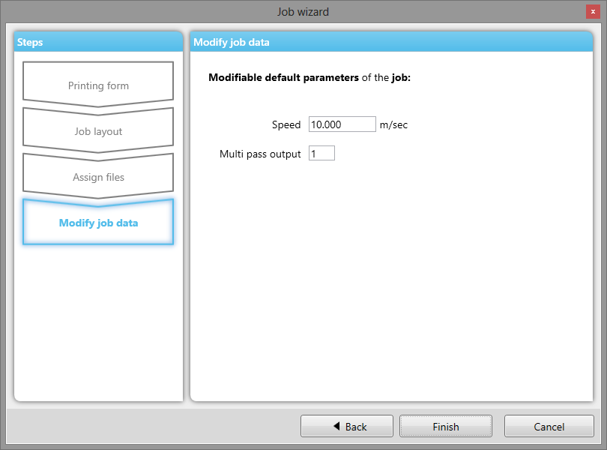
4
Optional change some default parameters of this job template.

Slide 8
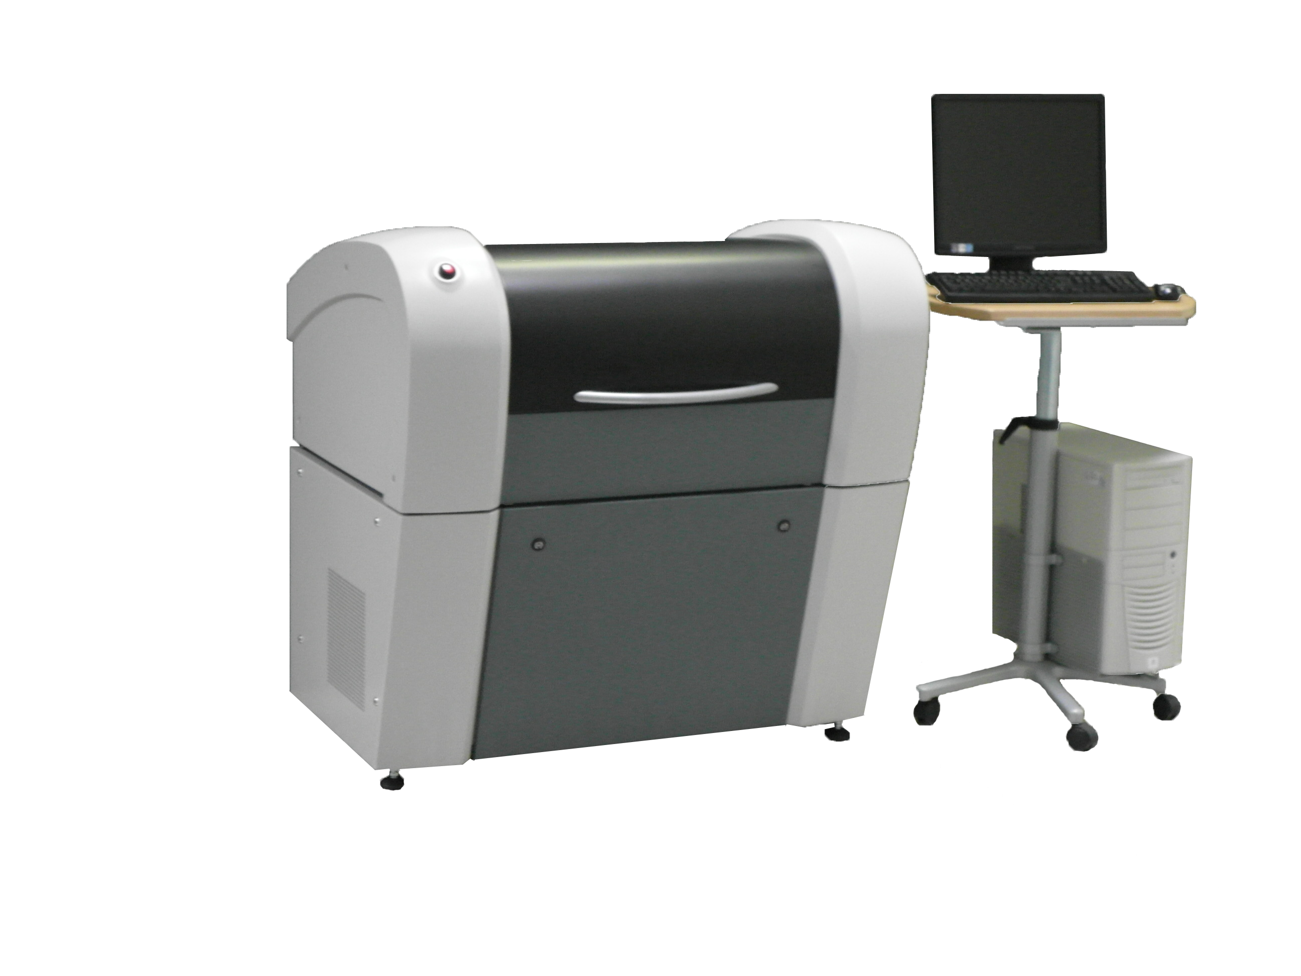
Supporting new Device DLX 703 (LAMS plate engraver + on the fly UV exposer).

Slide 9
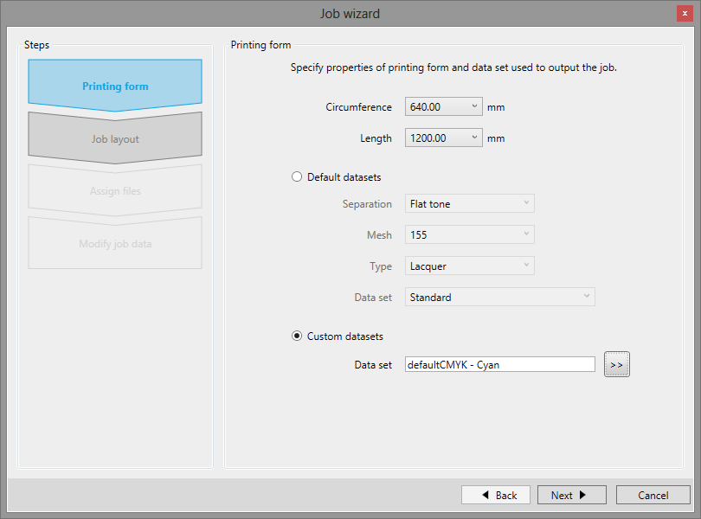
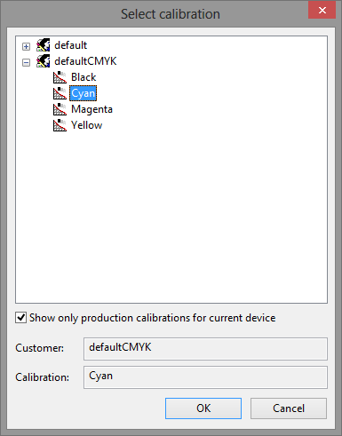
Job wizard for textile systems (based on CAM Plus)
Job creation has been revolutionary simplified and is now based on a wizard interview where customer just provides some basic information and the system generates the complete job in a couple of seconds.
Several approved machine settings for "SPG Prints Screens" are pre-installed.
  4 standard job templates are pre-installed:
  Standard templates range from very basic single file job layout up to a full featured job with registration marks and text sections.
  3 customer specific templates are free of charge:
  According to customers "technical drawing" templates featured job templates with registration marks, text fields (containing macros) and even Logo images can be created.
1
Select printing form dimensions and dataset.
Additional to prepared “standard datasets”
the professional user interface provides all “custom datasets” (production calibrations),
which customer already has prepared himself.

Slide 10
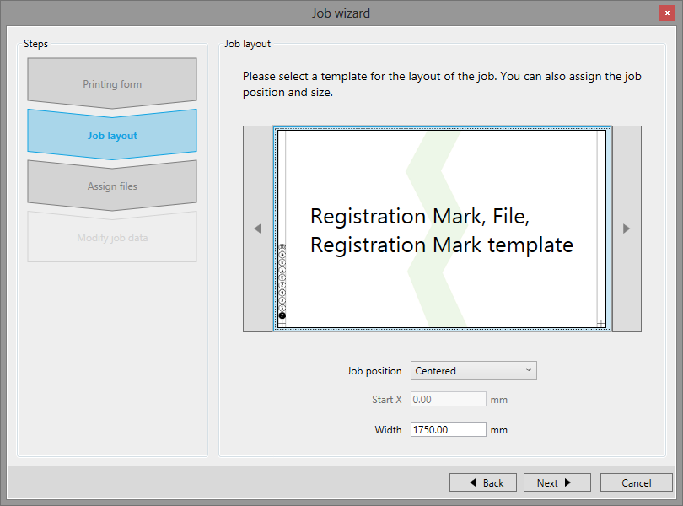
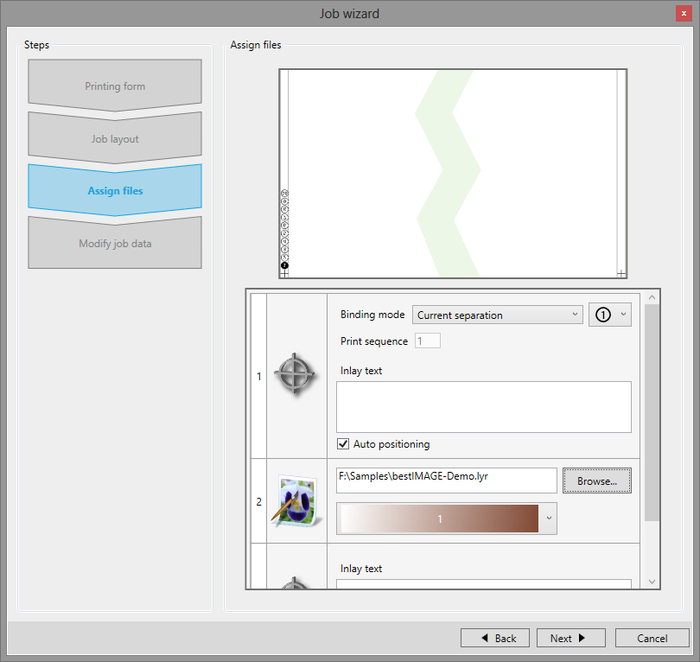
2
3
Select job layout and position
Select job object properties (files, text, print sequence mark shapes, etc.)

Slide 11
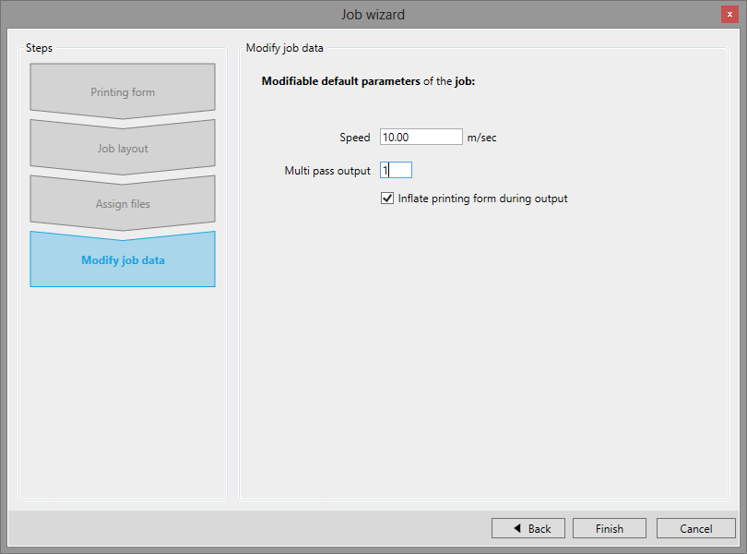
4
Optional change some default parameters of this job template.

Slide 12
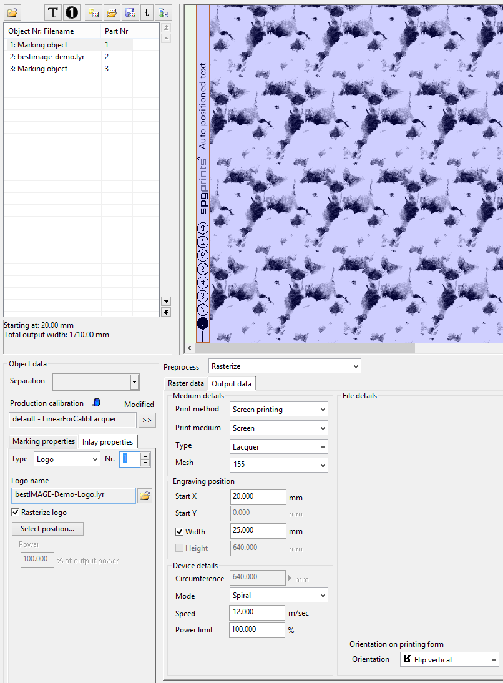
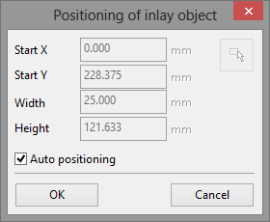
New option Auto positioning
for Text or Logo inside registration mark object makes it easy to make full featured registration marks on textile screens with less afford.
Position of Logo or
Text is automatically
each after the other.

Slide 13
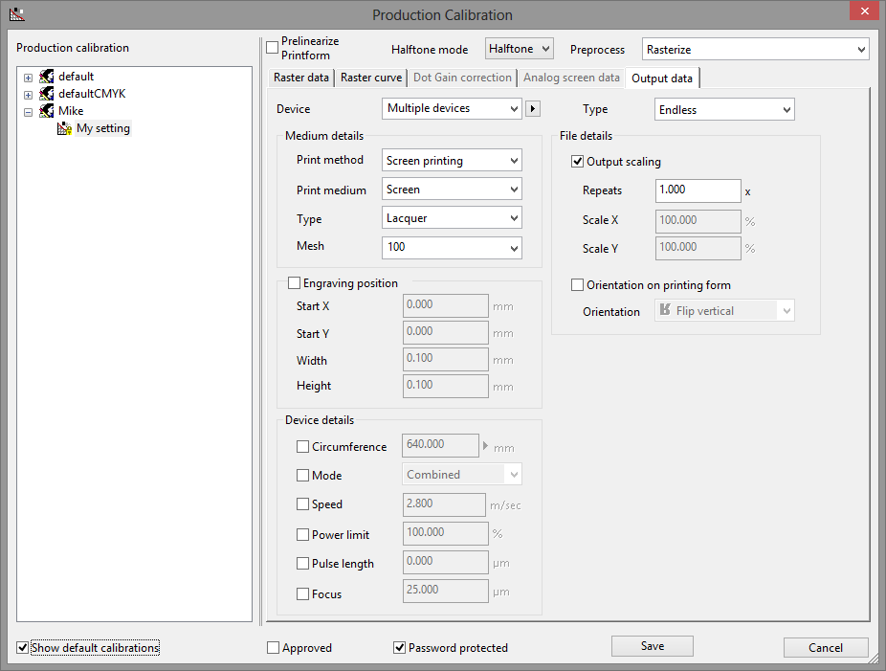
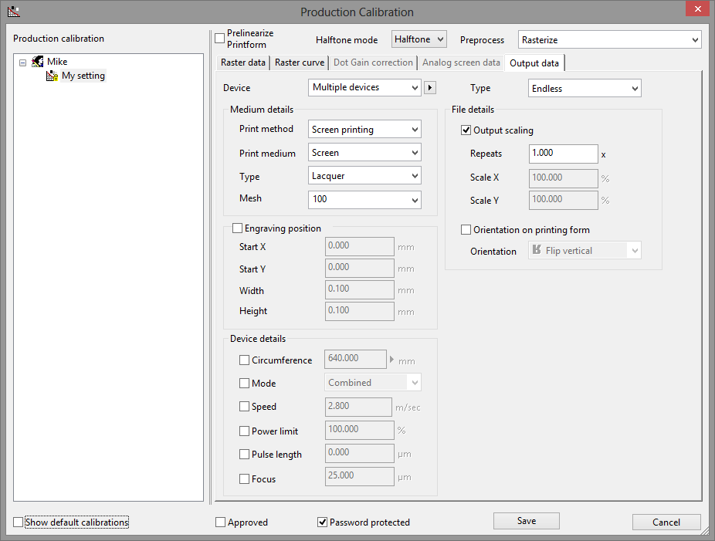
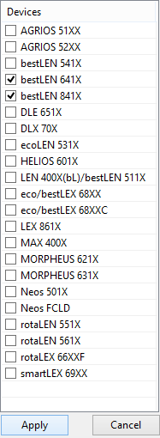
With new option Show default calibrations
it is possible to hide all default settings and just see customer specific settings.
It is now possible to create
production calibrations that are
assigned to more than one
device type.

Slide 14
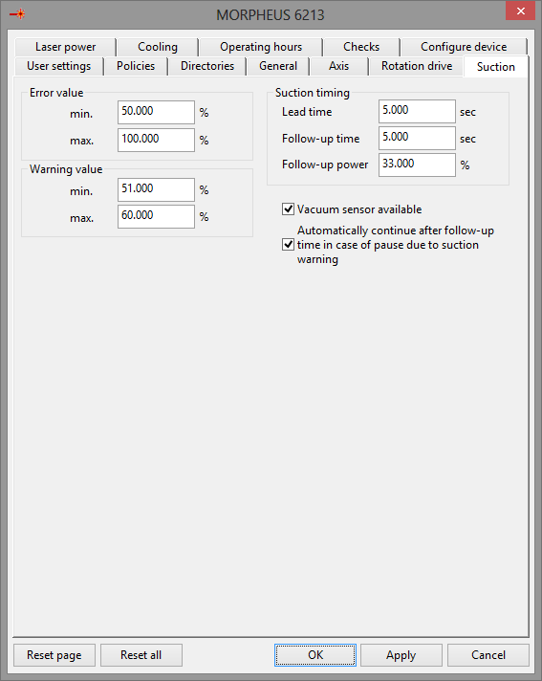
New option Automatic continue after suction warning
Machine can be configured to automatically continue the output after a suction warning. (but not suction error!)
Machine will go in Pause mode (optionally operator gets a SMS) then will reduce suction power and will enable the filter cleaning. After Follow-up time + 10 seconds machine assumes filter cleaning has successful finished and tries to continue
It will test if suction is out of warning range again and if no other errors are present and if all is OK it will continue (optionally operator gets a SMS).
If it can not continue it will stay in pause state so that operator can manually continue after solving the problem (optionally operator gets SMS).

Slide 15

Copyright © 2012 by Stork Prints Austria GmbH. Permission to copy without fee all or part of this material is granted provided that the copies are not made or distributed for direct commercial advantage and the Stork Prints Austria copyright notice appears. If the majority of the document is copied or redistributed, it must be distributed verbatim, without repagination or reformatting. To copy otherwise requires specific permission from Stork Prints Austria GmbH.
Stork Prints may make changes to specifications and product descriptions at any time, without notice.

